Slide 1
Teradata - Basics

Slide 2
Contents
Introduction to Teradata
Architectural overview
Major components of a TD system
Teradata Index types
Explain statement and Collect Stats
Some Performance considerations

Slide 3
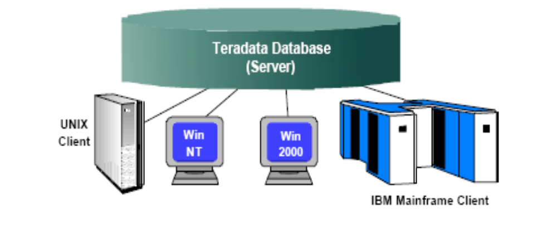
What is Teradata
Founded in 1979 in Los Angeles, California. In 1984, first TD product released based on Teradata Operating System (TOS). Ported to Unix OS in 1995 under AT&T. End of 2000, NCR created Teradata division and TD V2R5 was released by 2002.
An open system RDBMS, running on a Unix MP-RAS or Windows Server Platform
Capable of supporting many concurrent users from various client Platforms (over a TCP/IP or IBM channel connection)
Compatible with Industry standards (ANSI compliant)
Built on Parallel Architecture
1 TB means – 1000 GB/1 Trillion

Slide 4
Teradata for Data Warehouse
Supports more warehouse data than all competitors combined.
Easily scalable from a small (10 GB) to a massive (100+ GB) database.
Unlimited Parallelism
Provides a robust parallel-aware Optimizer
Automatic and even distribution
Multiple complex queries
Single Operational view of the entire MPP system (AWS) and single point of control for the DBA (TD Manager)
Lowest Total Cost of Ownership (DBA intervention is minimal)
High Availability
Automatic Fault tolerance

Slide 5
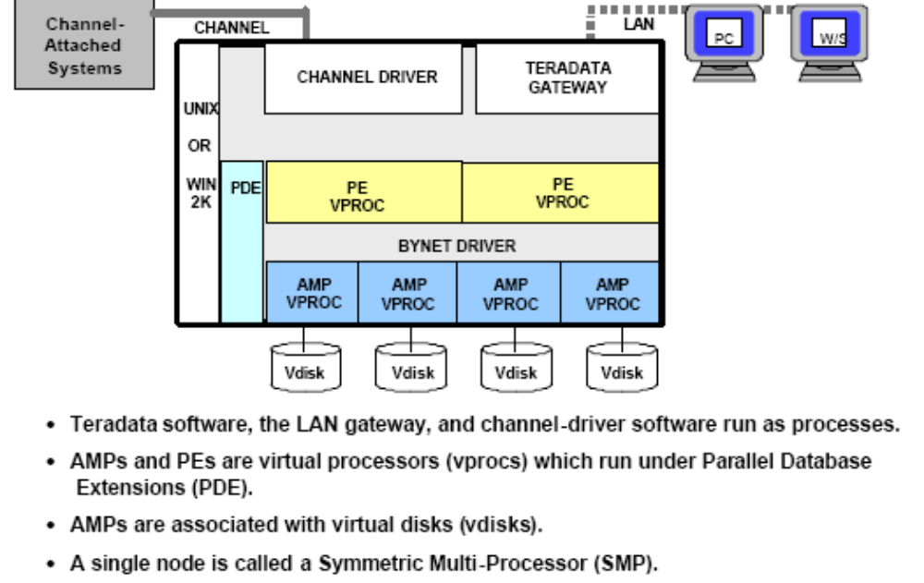
What is a Node

Slide 6
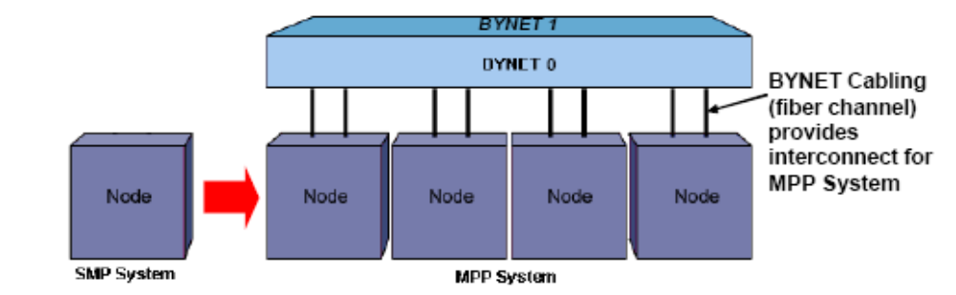
Teradata MPP Architecture
Multiple nodes are configured into Massively Parallel Processing (MPP) system
A physical message passing layer BYNET is used to interconnect multiple nodes
Teradata is linearly expandable – as your database grows, additional nodes may be added
The BYNET can support 512 nodes

Slide 7
Major Components of a Teradata System
PE (Parsing Engine)
BYNET
Access Module Processor (AMP)
Disks
Cliques
Hashing

Slide 8
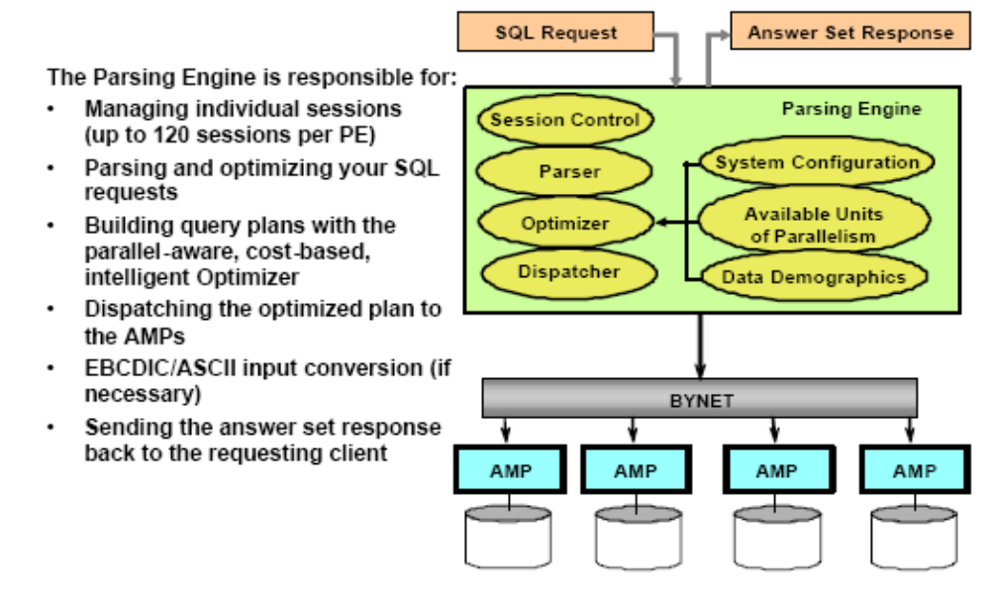
Parsing Engine (PE)

Slide 9
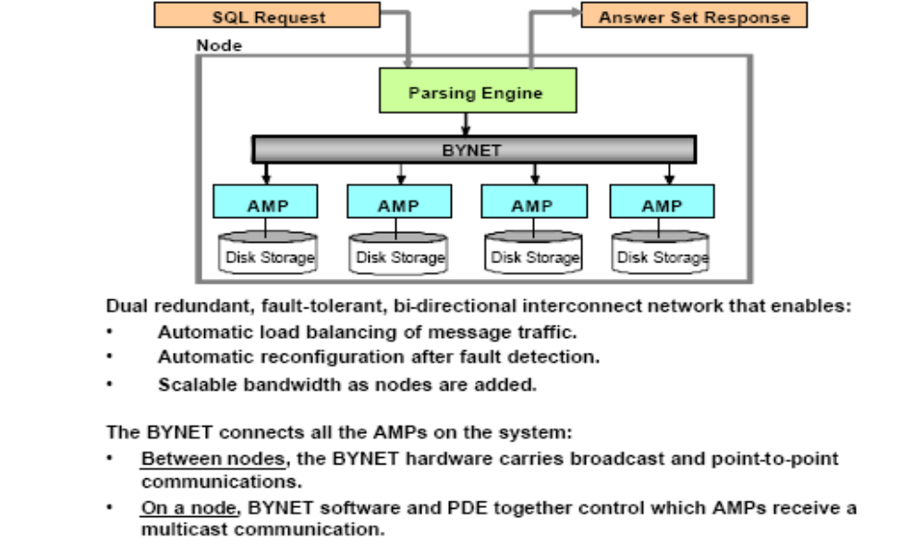
BYNET

Slide 10
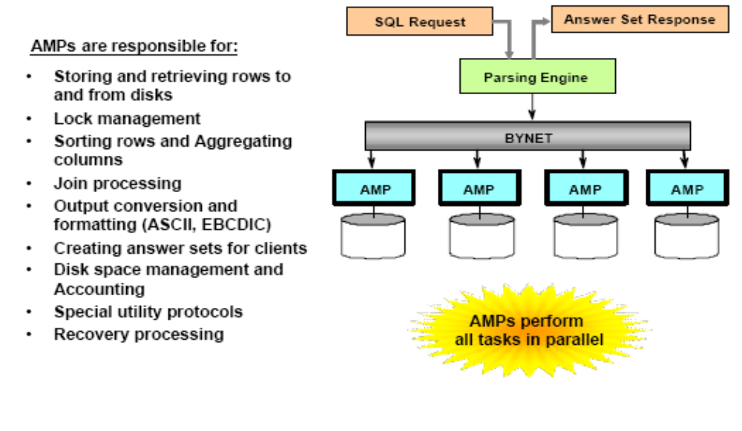
Access Module Processor (AMP)
Data Base Manager resides in each AMP which performs all the data related operations

Slide 11
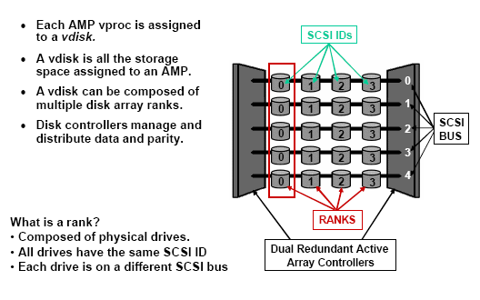
Disk Arrays
RAID 1 and RAID 5 are commonly used in Teradata for disk array protection

Slide 12
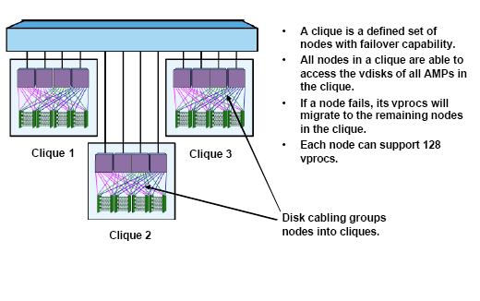
Cliques

Slide 13
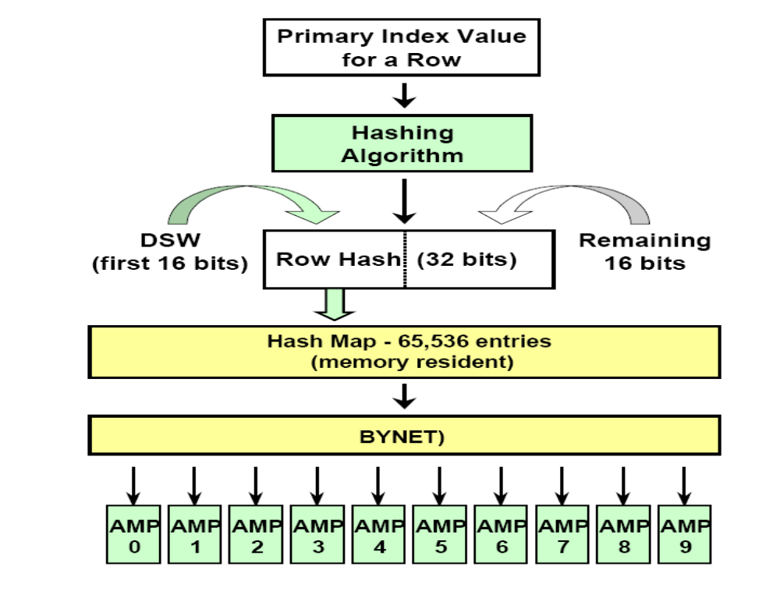
Hashing
AMP places 32 bit uniqueness value in front of Row Hash
32 bit Uniqueness value + 32 bit Row Hash = 64 bit ROW ID
For Join operations, every matching row should be in the SAME AMP

Slide 14
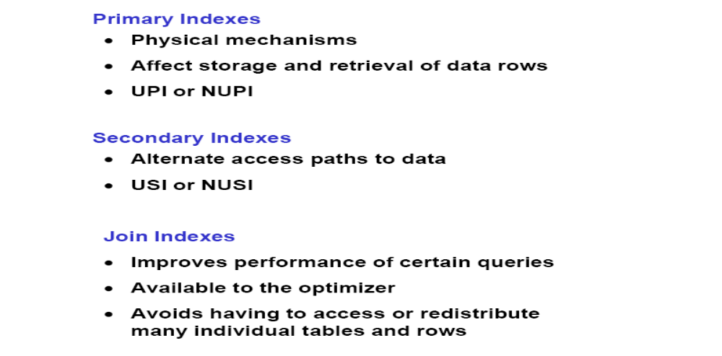
Index Types
Primary Index can be partitioned - PPI

Slide 15
Teradata Index – An Overview
Unique Primary Index
Very efficient
One AMP, One Row
No Spool File required
Non Unique Primary Index
Efficient if the number of rows per value is reasonable and there are no severe spikes
One AMP, Multiple Rows
Spool file if needed
Unique Secondary Index
Very efficient for data retrieval
Two AMPS, two rows (1 index row; 1 data row)
Sub-table required
No spool file required
Non Unique Secondary Index
Efficient only if the number of rows accessed is a small percentage of the total data rows in the table
All AMPS, Multiple rows
Spool file required

Slide 16
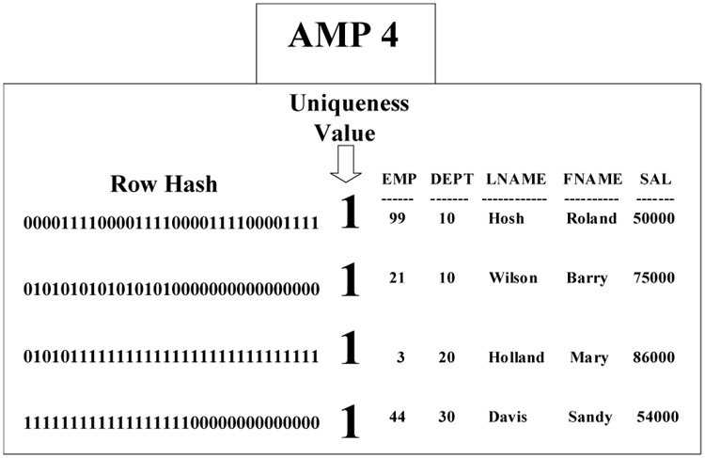
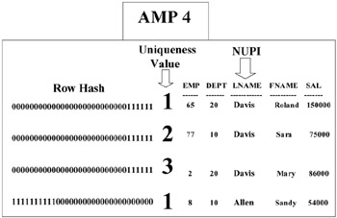
Primary Index – Physical Layout
Unique Primary Index – An example
Non-Unique Primary Index – An example

Slide 17
Partitioned Primary Index - PPI
PPI are used to further divide the data distribution on AMPs into buckets to improve retrieval
Best for queries that specify Range based constraints
Partitioning by CASE_N, RANGE_N or a single column
NO CASE, NO RANGE, UNKNOWN option is available for exclusion sets
PPI reduces number of rows that are processed by using Partition Elimination – Eliminates FTS
Efficient than secondary indices – FLOAD and MLOAD can work with PPI but not with secondary indices
RANGE_N: DW_UAS_SM
PRIMARY INDEX ( USER_ID )
PARTITION BY RANGE_N
(ACTVTY_MONTH_BEG_DT
BETWEEN
DATE '2000-04-01‘ AND DATE '2005-12-31' EACH INTERVAL '1' MONTH ,
DATE '2006-01-01' AND DATE '2006-03-31' EACH INTERVAL '1' MONTH ,
DATE '2006-04-01' AND DATE '2006-06-30' EACH INTERVAL '1' MONTH ,
DATE '2006-07-01' AND DATE '2007-12-31' EACH INTERVAL '1' MONTH ,
NO RANGE);
CASE_N: DW_LSTG_ITEM_REV
PRIMARY INDEX (ITEM_ID)
PARTITION BY CASE_N
(NET_REV_USD < 100,
NET_REV_USD < 1000,
NET_REV_USD < 10000,
NO CASE,
UNKNOWN);

Slide 18
Secondary Indices
Unique Secondary Index (USI)
Provides another path to access data
Used to enforce uniqueness on a primary key. For MULTISET tables, highly recommended to avoid duplicate row check
Up to 32 secondary index can be created and each index will have its own sub table in each AMPs
Secondary Index sub table consists of : Secondary Index Value, Secondary Index Row ID, Primary Index Row ID
Additional perm space is required to store sub table
Non Unique Secondary Index (NUSI)
NUSI queries are All-AMP Operations but not FTS
NUSI sub tables are AMP local
Value ordered NUSI can be any non-unique index of integer type
Always collect Statistics on all NUSI indexes

Slide 19
Explain Plans
The EXPLAIN facility provides an "English" translation of the plan the SQL Optimizer develops to service a request.
Used for Performance optimization on SQLs
Execution time and Row count are for estimates ONLY and Actual may differ
Collect Statistics will help the optimizer to provide more efficient execution plans
Explain Plan Skeleton:
Step 1: Lock tables.
Step 2: All AMP retrieves by row hash scan, and joined to the other table by merge join. The joined result is sent to spool.
Step 3: Perform transformation or aggregations if any.
Step 4: End transaction and release locks.
Step 5: The content of Spool sent to the user.

Slide 20
Most Common Explain Keywords and their meaning
Explain Keywords | Description
All-AMPs JOIN STEP BY WAY OF AN ALL-ROWS SCAN | On each AMP, which the rows reside, spooled rows or primary table rows are searched row by row until the join condition are joined and satisfied
All-AMPs JOIN STEP BY WAY OF A ROW HASH MATCH SCAN | The first row is retrieved from the first table; that row's hash code is used to locate a row from the second table.
All-AMPs RETRIEVE STEP BY WAY OF AN ALL ROWS SCAN | All rows of a table are selected row by row on all AMPs on which the table is Stored (A Full Table Scan operation)
ESTIMATED SIZE | This value, based on any statistics collected for a table, is used to estimate the size of the spool file needed to accommodate spooled data. If statistics have not been collected for a table, this estimate may be grossly incorrect.
ESTIMATED TIME | This approximate time is based on average times for the sub operations that comprise the overall operation, and the likely number of rows involved in the operation. The accuracy of the time estimate is also affected by the accuracy of the estimated size.
WITH A RESIDUAL CONDITION | All applicable conditions have been applied to the rows.
BY WAY OF A ROW HASH MATCH SCAN | A merge join is done on hash values
LAST USE | A spool file is no longer needed. It will be freed up after this step.
WHICH IS REDISTRIBUTED BY HASH CODE TO ALL AMPS | Redistributing each of the data rows for a table to a new AMP based on the hash value for the column or columns involved in a join. (Try to avoid redistribution of data)
WHICH IS BUILT LOCALLY ON THE AMPs | Each AMP builds a portion of a spool file from the data found on its local disk.
WE DO AN SMS | A Set Manipulation Step caused by a union, minus, or intersect operation.
AGGREGATE INTERMEDIATE RESULTS ARE COMPUTED LOCALLY | Aggregation requires no redistribution
ELIMINATING DUPLICATE ROWS | Eliminating duplicate rows in the spool files. Using the distinct command does this.
END TRANSACTION | All Transactions are released and changes are committed.

Slide 21
Collect Statistics
The optimizer needs the following demographics to plan the best way to do a query:
How many rows in the table?
Is the column indexed?
Is the index Unique or Non-Unique?
How many distinct values are there in the column?
How many rows per value can be expected
It uses COLLECTed STATISTICS if they are available
If not, it uses a RANDOM AMP SAMPLE / Dynamic Sampling to derive its demographics
Table ID is used to select an AMP
Badly distributed data gives skewed samples that impact optimization
Collecting Stats can be beneficial in:
Improve the performance of complex queries and joins
Enable the optimizer to utilize NUSI bit mapping over FTS
Helpful in accessing a column or index with uneven value distribution

Slide 22
Some Performance Considerations
Avoid Product Joins
Product Joins are costly operation which requires huge spool space and CPU time
Caused by – Missing WHERE clause, Too few join conditions, A referenced table not participating in Joins, Incorrect usage of table alias etc.,
Try to avoid product joins with the use of Explain plans
Avoid Data Skewness
Caused due to poor selection of Primary Index
May lead to HOT AMP situation where skewed AMP consumes more resource while other AMPs are idle
Carefully select the PI which is vital
Handling “No more spool space” error
Spool space is used to store the intermediate results during query execution and limited
Carefully consider the join operations and column selections to reduce spool space usage
Explain plans can be used for some extent to identify this issue
Data Compression (Value List Compression - VLC)
Compressing data will help in many ways – Reduced space, making row size smaller, reduce I/O operation
Up to 255 distinct values (including NULL) may be compressed per fixed-width column
Data Type Conversion
Data type conversion is a costly operation especially in Join operations.
Joining columns are recommended to have same data type to improve performance

Slide 23
Q & A
THANK YOU ☺

